Slide 1
Cable Design Project
Everett Barry, Jr.
METC 143
December 16, 2015

Slide 2
Problem Statement
The task is to design a cable that will support a 60 ton vehicle. The cable is 25 foot long and can have an elastic deformation of no more than 10%. Using the Modulus of Elasticity for various metals design a cable. Use standard cable diameter sizes listed below (units are inch):
2
1 3/4
1 1/2
1 1/4
1
3/4
1/2
3/8
1/4
3/16
1/8
1/16
1/32
1/64

Slide 3
Introduction
In order to find out what material to be used in the creation of the 25 foot cable I had to utilize various factors to calculate. I first had to understand my limits that the cable cannot stretch no more than 27.5 feet while lifting a 60 ton vehicle. I needed the modulus of elasticity and thermal expansion coefficients of several materials. This problem took a great amount of mathematical calculations.

Slide 4
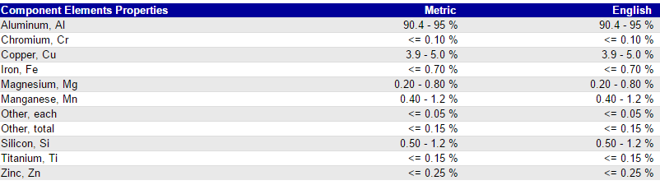
Results – Material Information
2014-T6 Aluminum

Slide 5
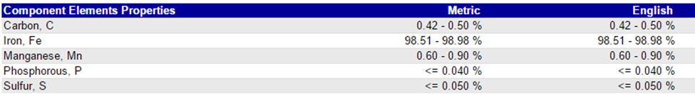
Results – Material Information
1045 Steel

Slide 6
Results – Material Information
Copper

Slide 7
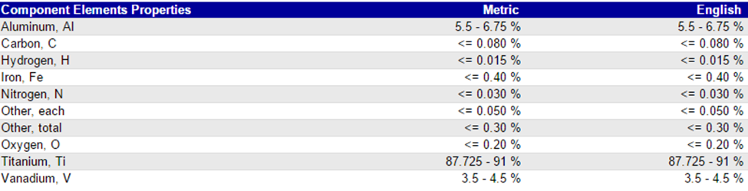
Results – Material Information
Titanium Ti-6Al-4V (Grade 5), Annealed

Slide 8
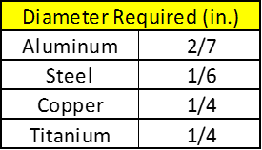
Results - Calculations
Calculated Diameter Required for Each Material Based on Modulus of Elasticity.

Slide 9
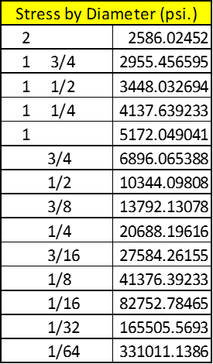
Results - Calculations
Stress Calculations Based on all common diameter sizes given in Project Instructions.

Slide 10
Results - Calculations
Stress vs Diameter

Slide 11
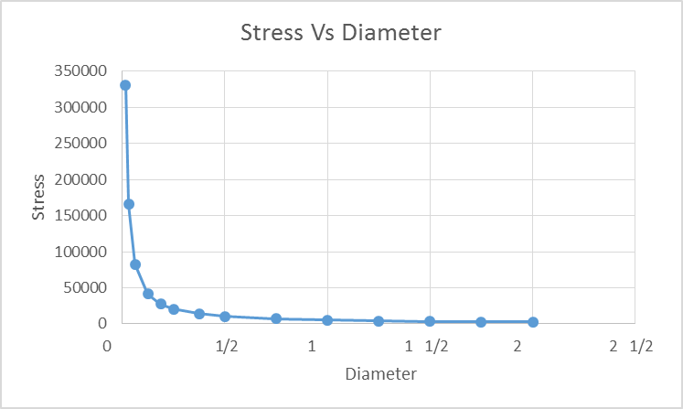
Results - Calculations
Stress vs. Diameter Plot

Slide 12


Fatigue Analysis
For my selected diameter, I calculated the stress generated for aluminum and steel.
The maximum number of cycles you can get out of aluminum during it operation is approximately 100,000 cycles in its life time. The maximum number of cycles you can get out of steel during it operation is approximately 1,000,000 cycles in its life time.

Slide 13
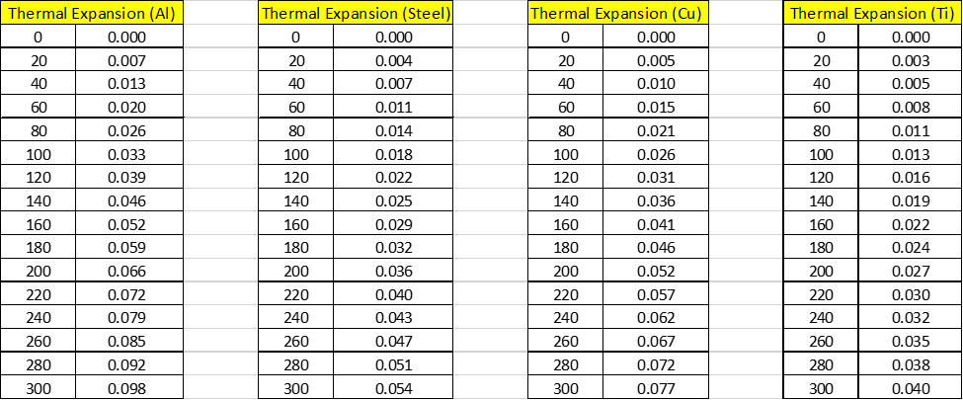
Thermal Analysis
Here is the thermal Expansion of each material.

Slide 14
Conclusion
I chose a 1 inch diameter because I felt safer with it being the strongest. I would feel most at peace at mind for the crew and operator due to the fact that the cable can operate well and beyond the minimum requirements safe. You can never be too safe.
I chose steel as my material because it not as expensive as titanium. I can be made out of recycled steel which is not so scarce. It is strong enough to handle a 60 ton vehicle. It can get the job done without breaking the bank. You can also get a whole magnitude amount of more cycles compared to aluminum.

Slide 15
Thank You
This has been a very educational and applicable course this semester. I commend you for excellence. Not bad for first time teaching. You have great potential professor.

